Slide 1
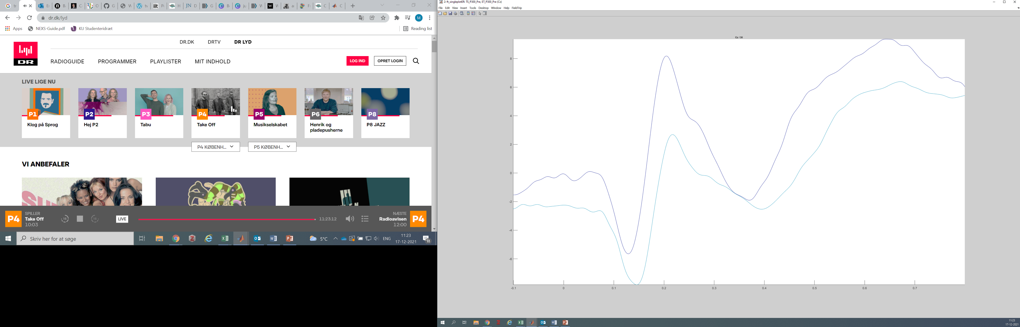
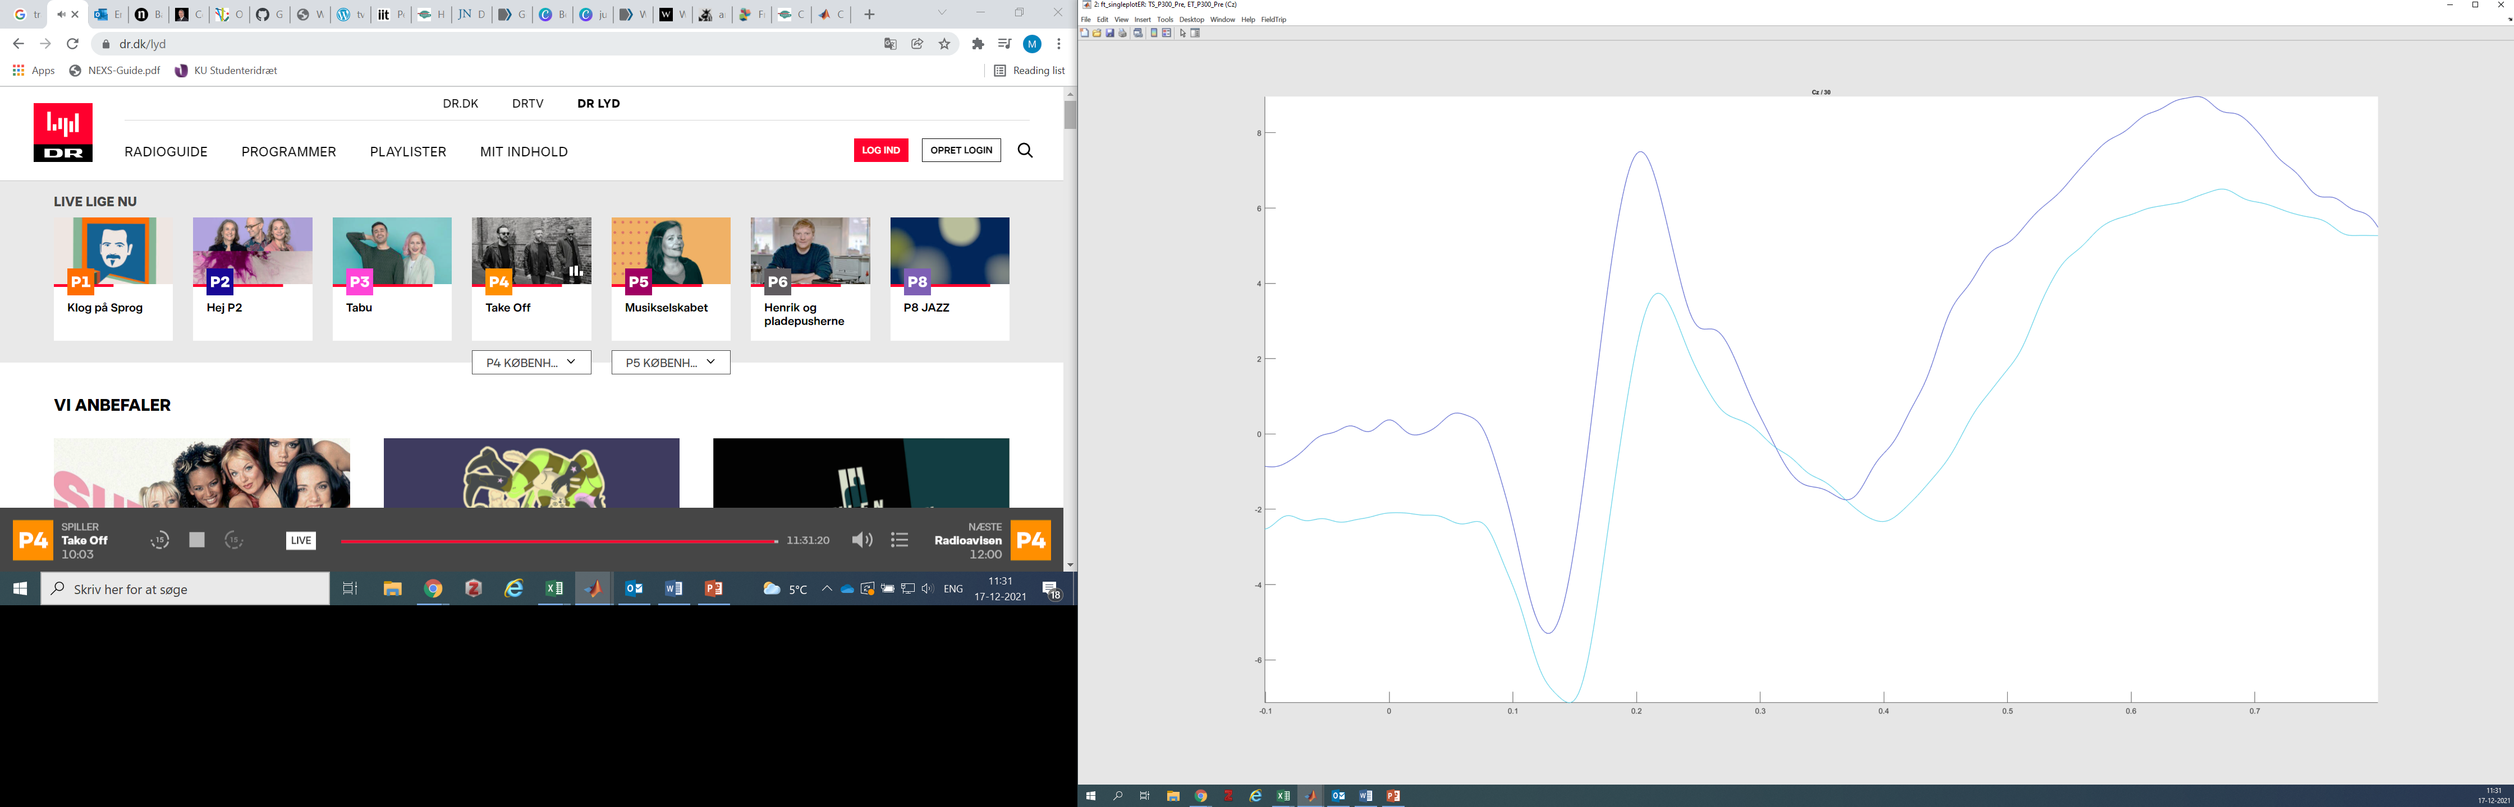
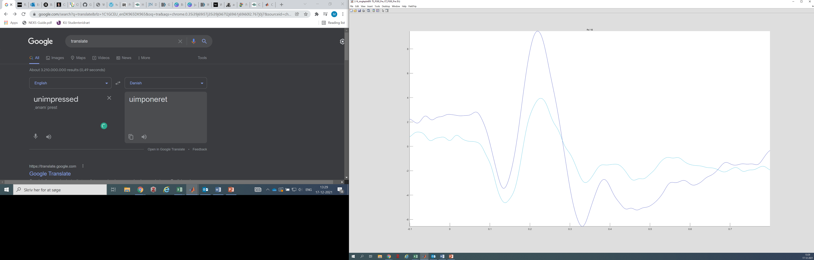
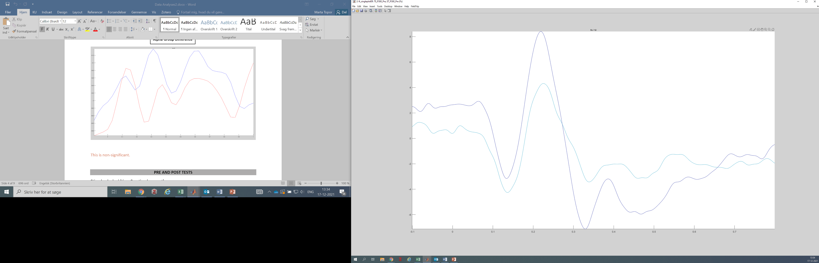
P300 baseline by intervention
Cz P300 at 150-300ms is significant at p<.001
P300 at 150-300ms is significant at p<.001
Cz
Cz
Fz P300 at 150-300ms is significant at p=.016
Fz P300 at 150-300ms is non-significant at p=.053
Fz
Fz
20 Participants, Outliers removed, Divided by Intervention Group
18 Participants, Outliers removed, Divided by Intervention Group
Touch Screen
Eye Tracker
P300 during the intervention will be compared between the groups on the Fz

Slide 2
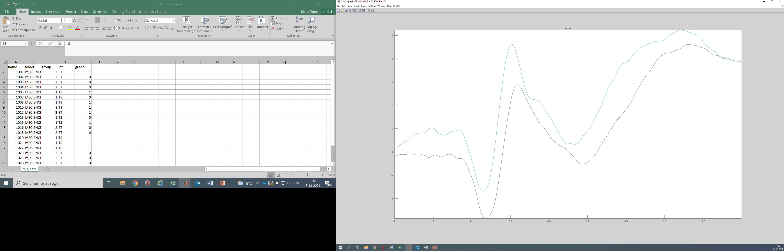
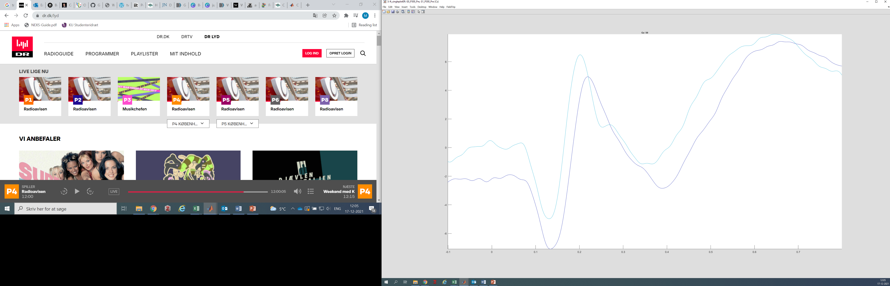
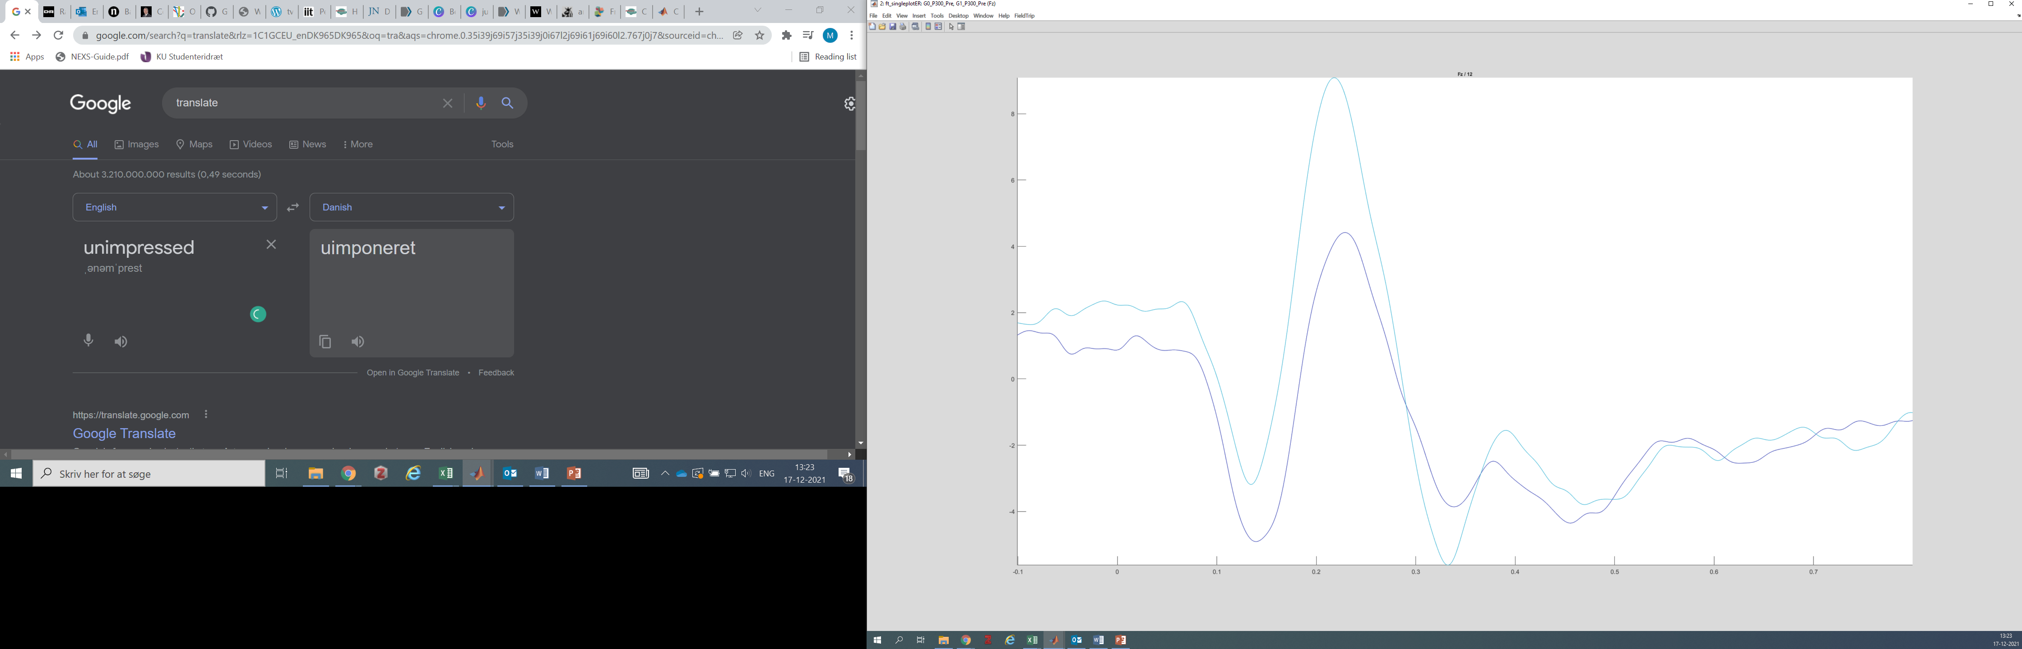
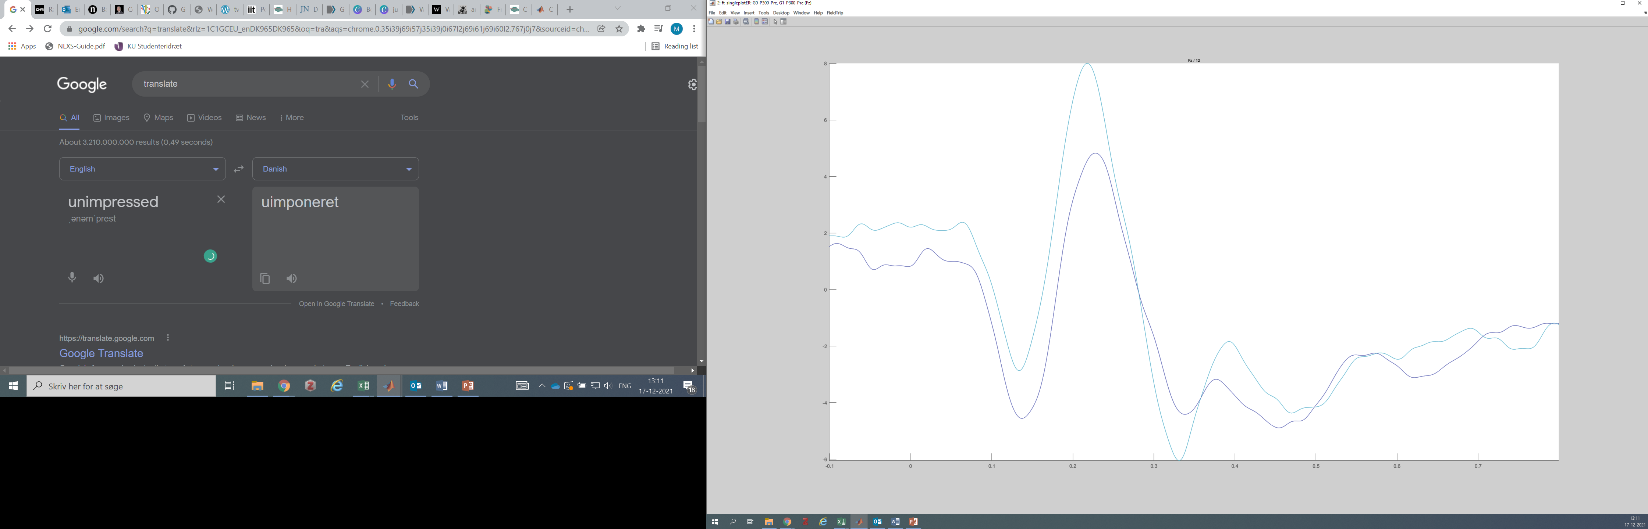
P300 baseline by age
P300 at 150-300ms is significant at p<.007
Cz P300 at 150-300ms is significant at p=.021
Cz
Cz
Fz P300 at 150-300ms is significant at p=.016
Fz P300 at 150-300ms is inconclusive at p=.031
Fz
Fz
20 Participants, Divided by Age (10 in each group)
18 Participants, Outliers removed, Divided by Age (9 in each group)
Grade 1
Grade 0

Slide 3
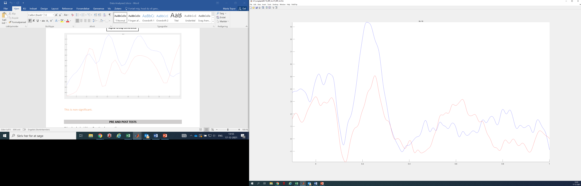

P300 Intervention
Fz P300 at 150ms-300ms during Intervention Significant p=.002
Fz P300 at 150ms-300ms during Intervention Significant p=.003
18 Participants, Outliers removed, Divided by Age (9 in each group)
20 Participants, Divided by Age (10 in each group)
Touch Screen
Eye Tracker

Slide 4
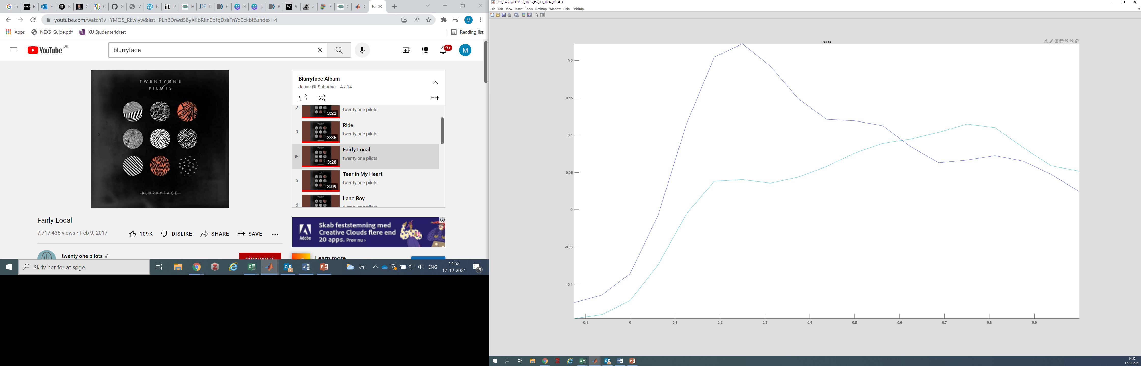
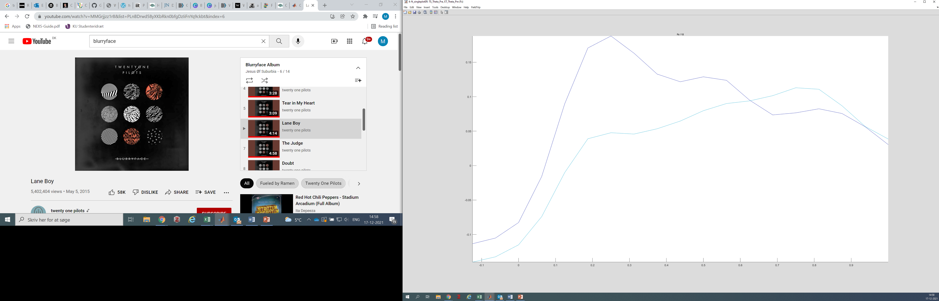
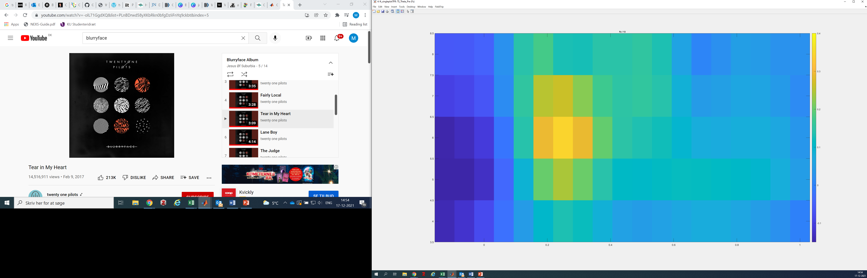
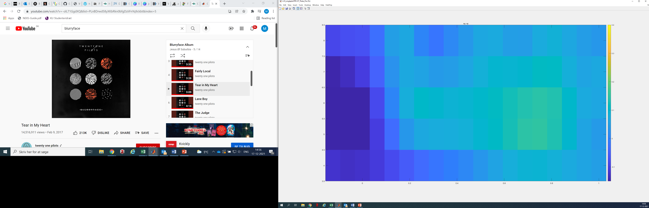
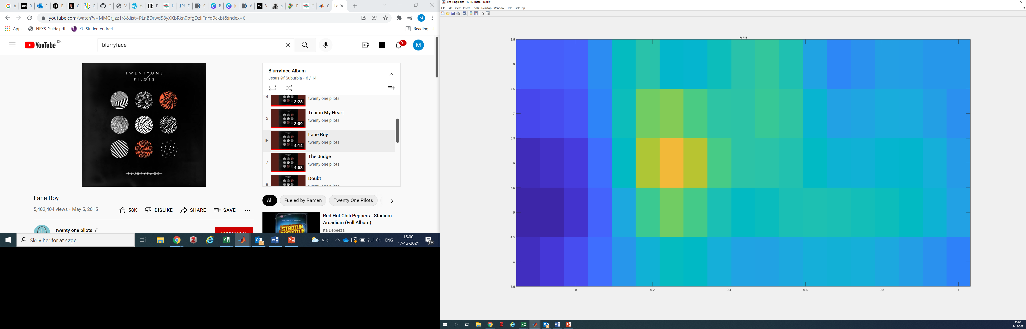
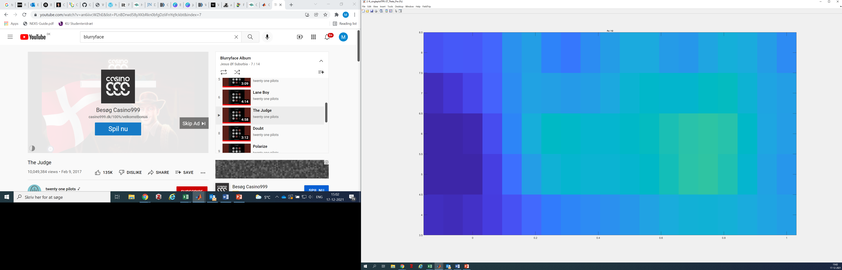
Theta baseline by intervention
Fz Theta at 0-600ms is inconclusive at p=.043
Fz Theta at 0-600ms is non-significant at p=.162
Fz
Fz
Touch Screen
Eye Tracker
Touch Screen
Eye Tracker
20 Participants, Outliers removed, Divided by Intervention Group
18 Participants, Outliers removed, Divided by Intervention Group
Touch Screen
Eye Tracker
P300 during the intervention will be compared between the groups at Fz

Slide 5
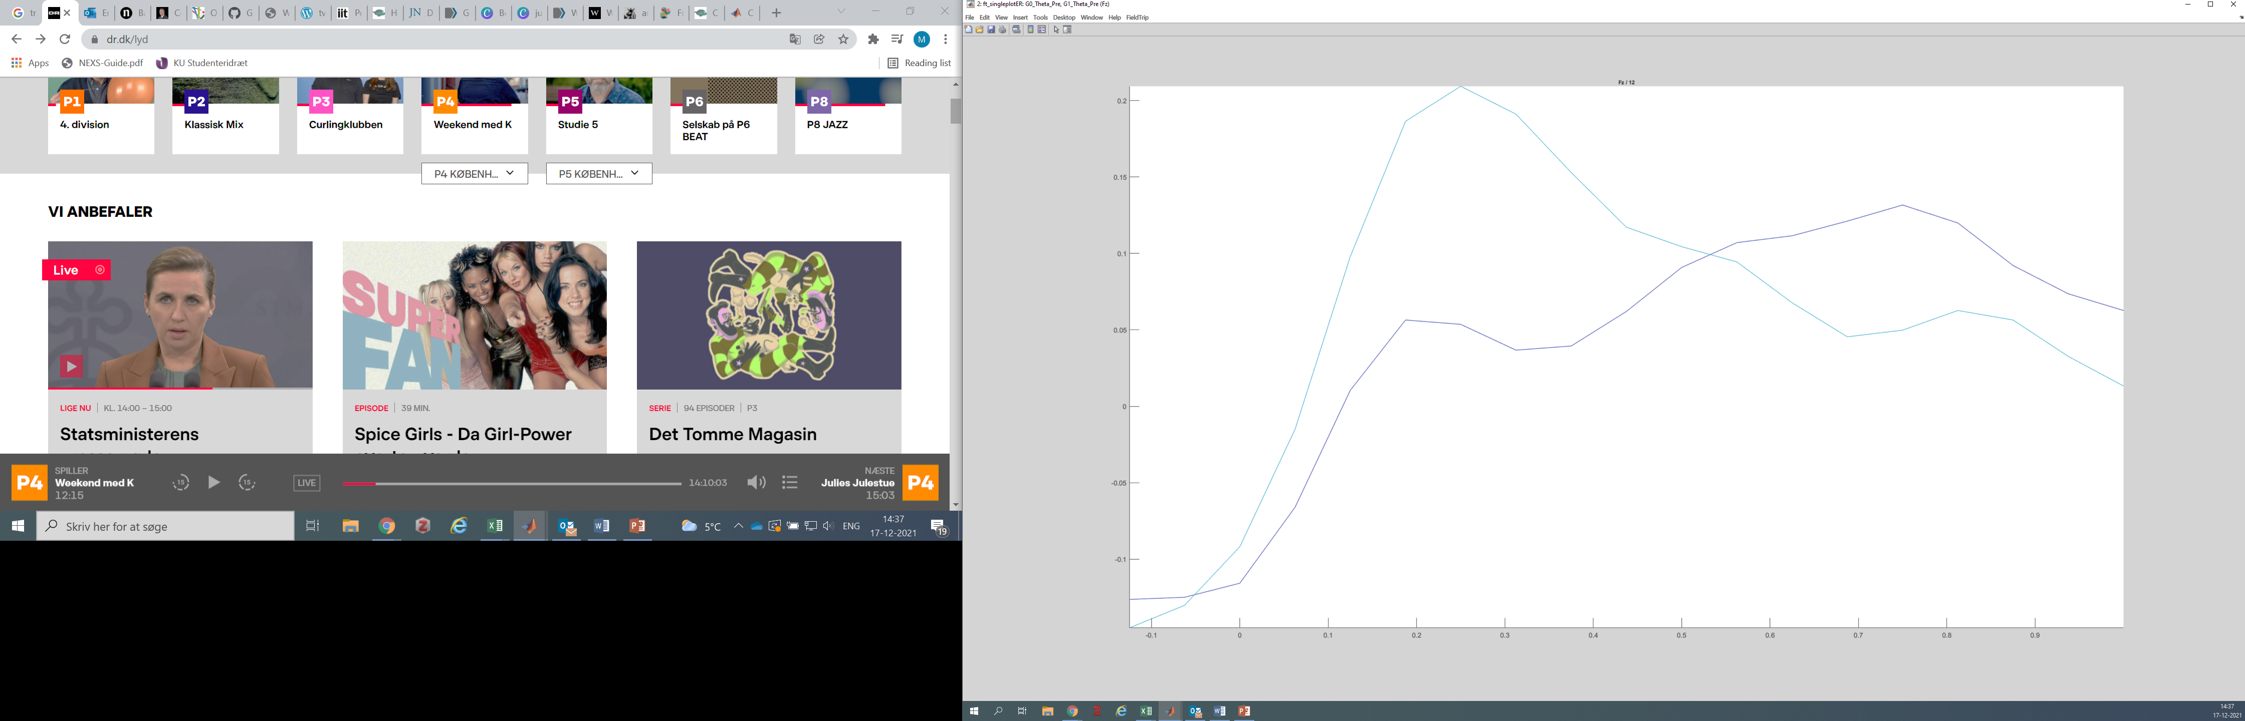
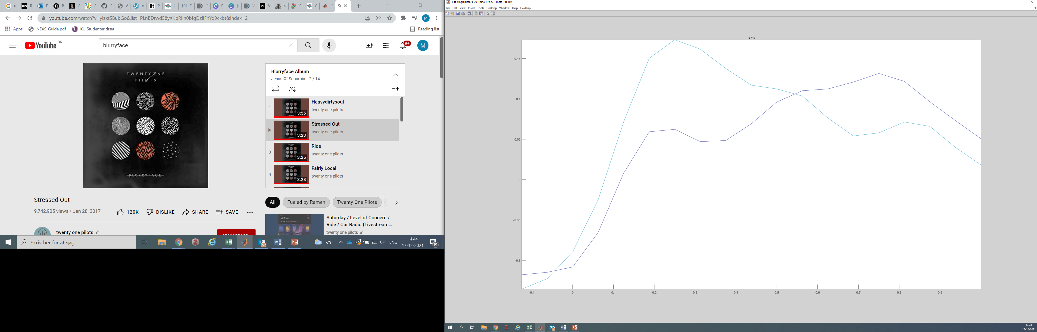
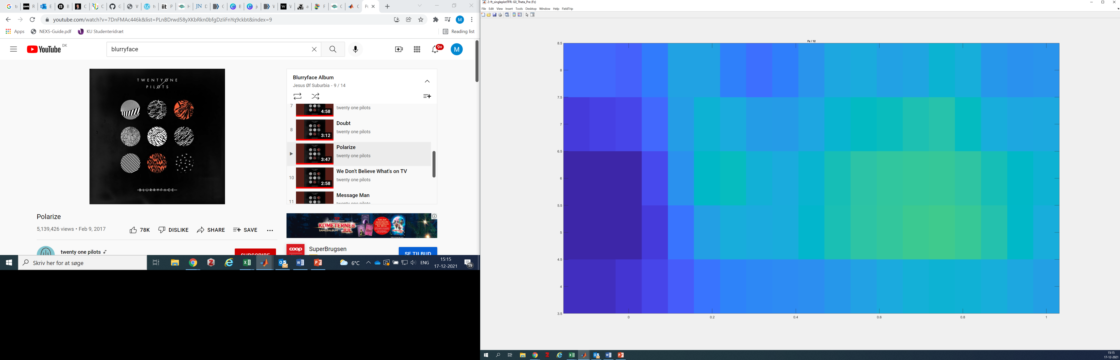
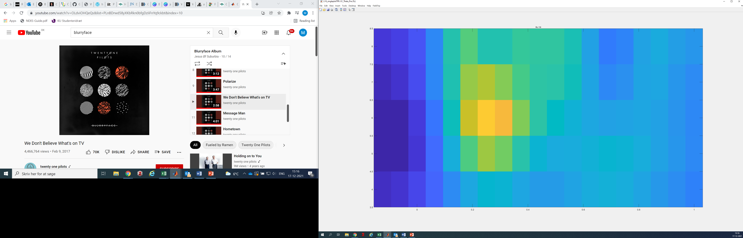
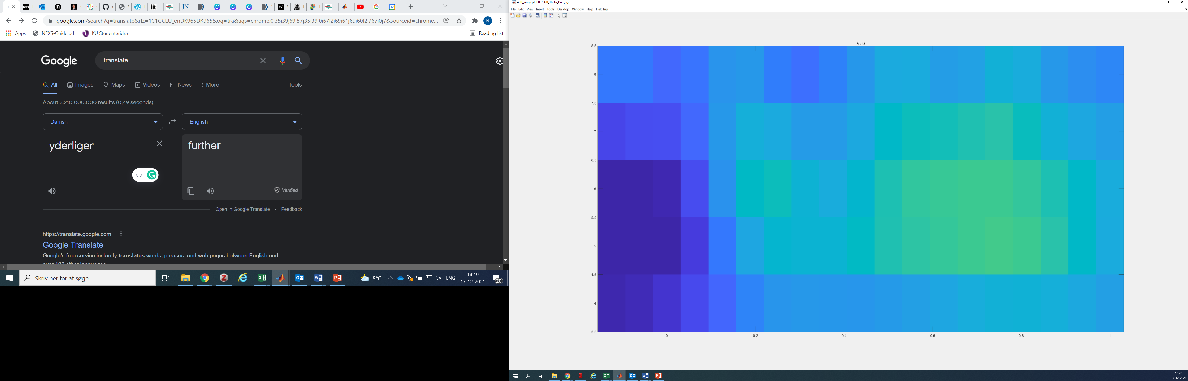
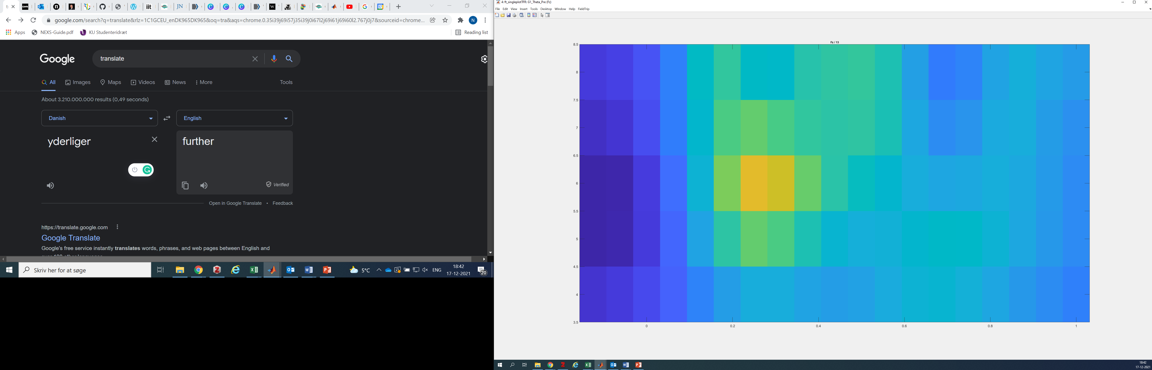
Theta baseline by age
Fz Theta at 0-600ms is non-significant at p=.058
Fz Theta at 0-600ms is non-significant at p=.121
Fz
Fz
Grade 0
Grade 1
Grade 0
Grade 1
20 Participants, Divided by Age (10 in each group)
18 Participants, Outliers removed, Divided by Age (9 in each group)
Grade 1
Grade 0

Slide 6
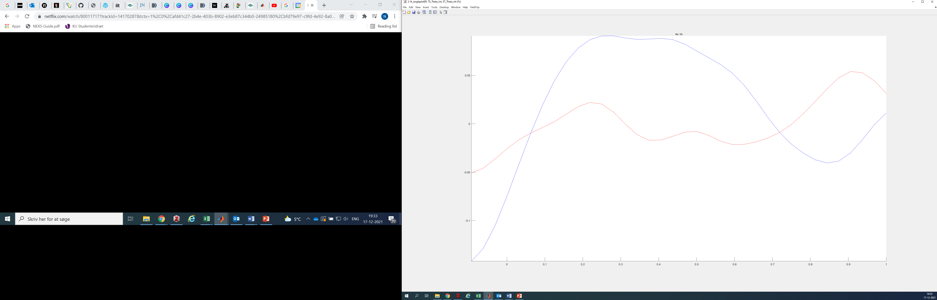
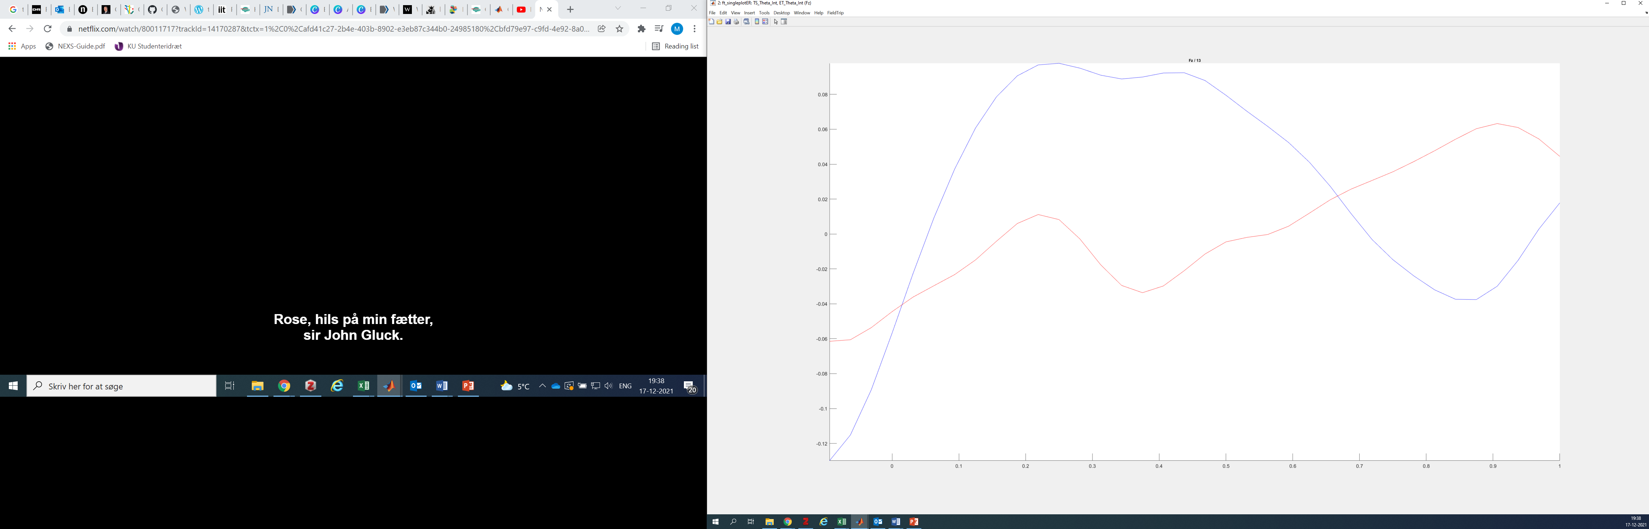
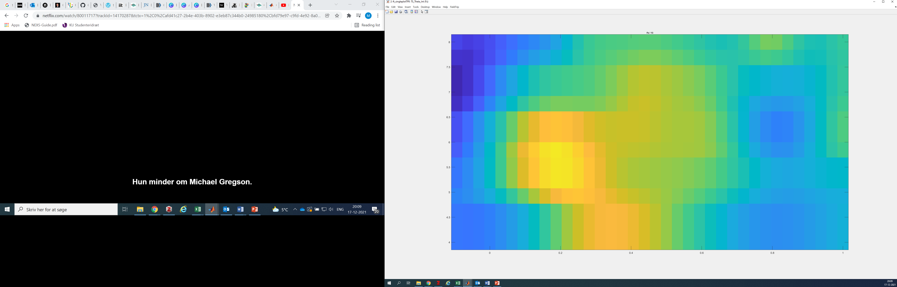
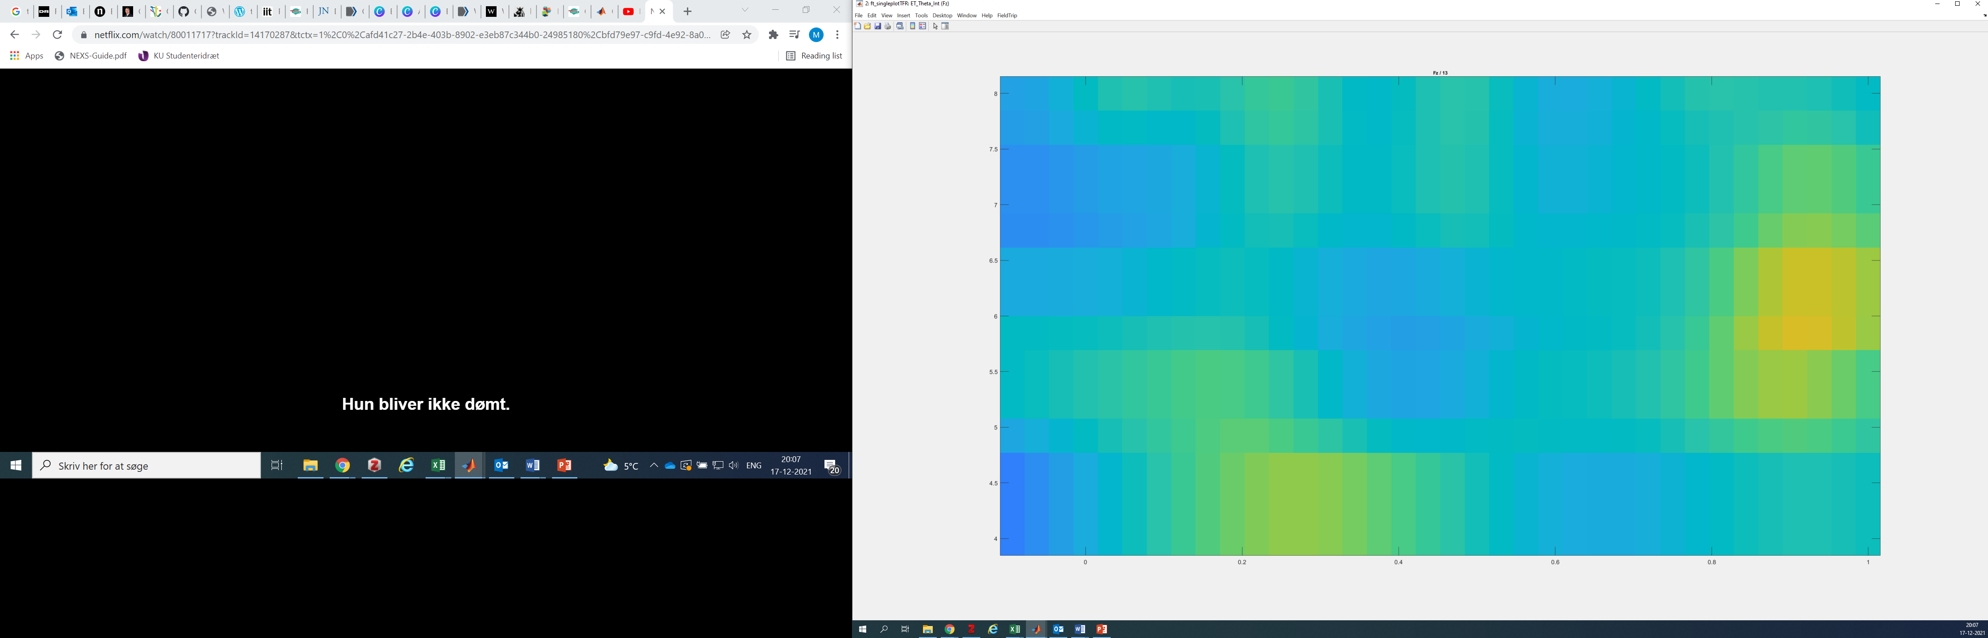
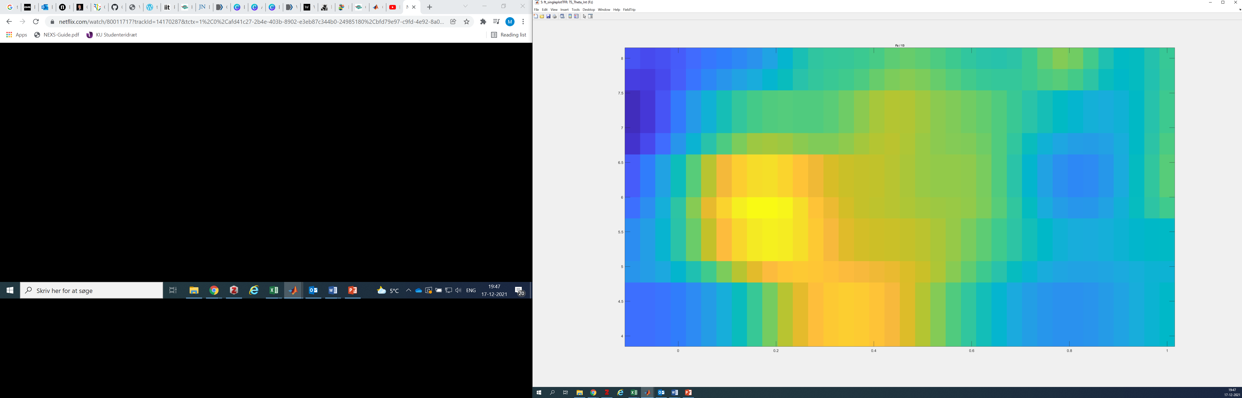
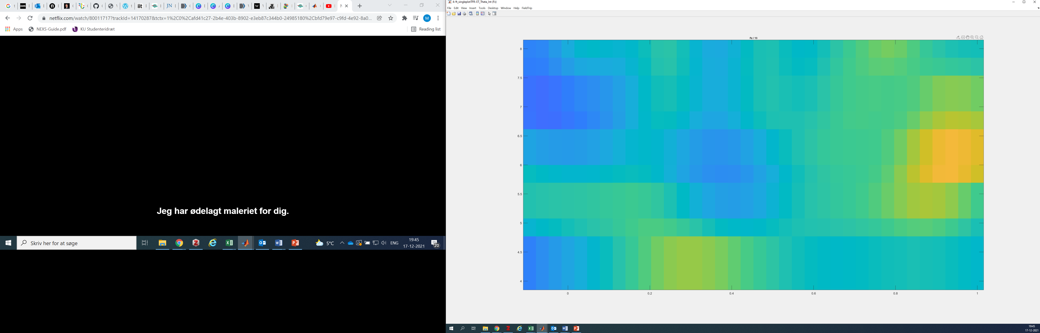
Theta Intervention
Fz Theta at 0ms-600ms during Intervention non-significant p=.356
Fz Theta at 0ms-600ms during Intervention non-significant p=.057
Touch Screen
Eye Tracker
Touch Screen
Eye Tracker
20 Participants, Divided by Age (10 in each group)
18 Participants, Outliers removed, Divided by Age (9 in each group)
Touch Screen
Eye Tracker

Slide 7
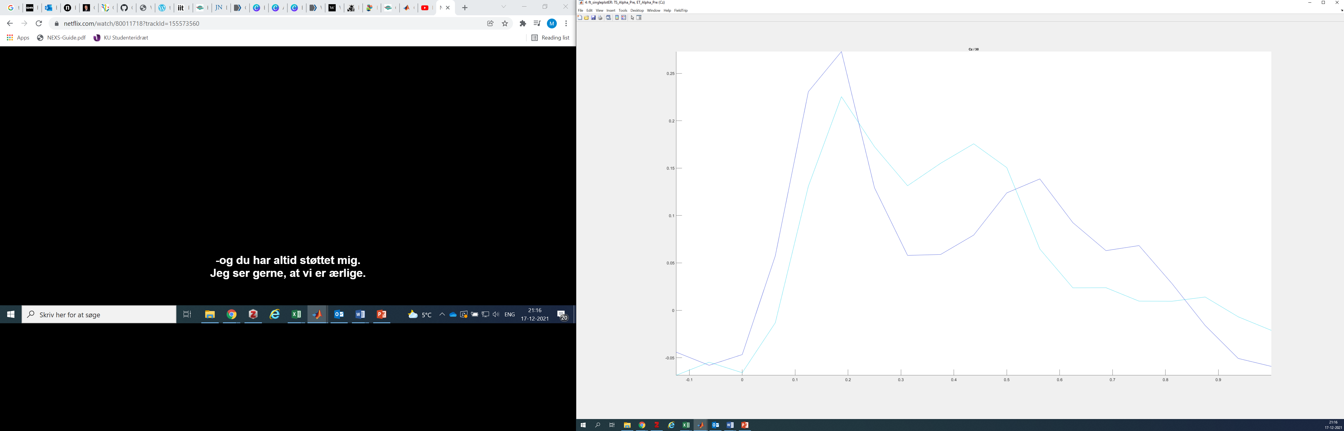
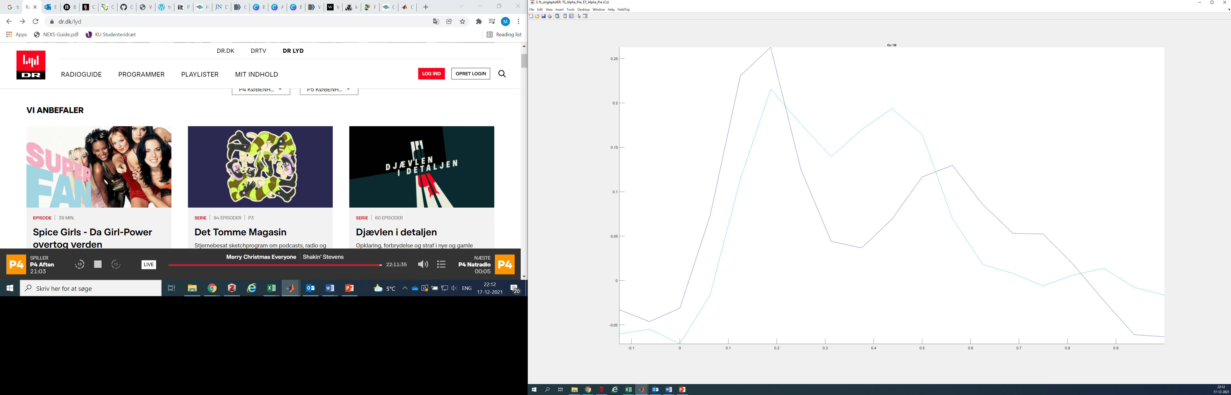
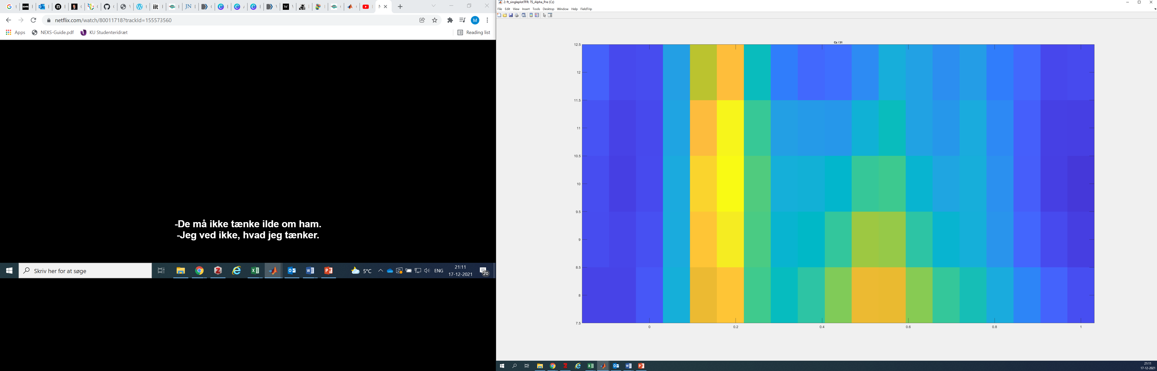
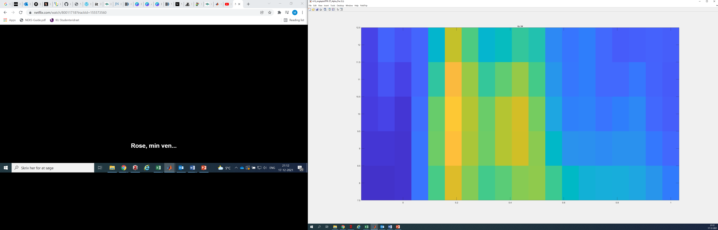
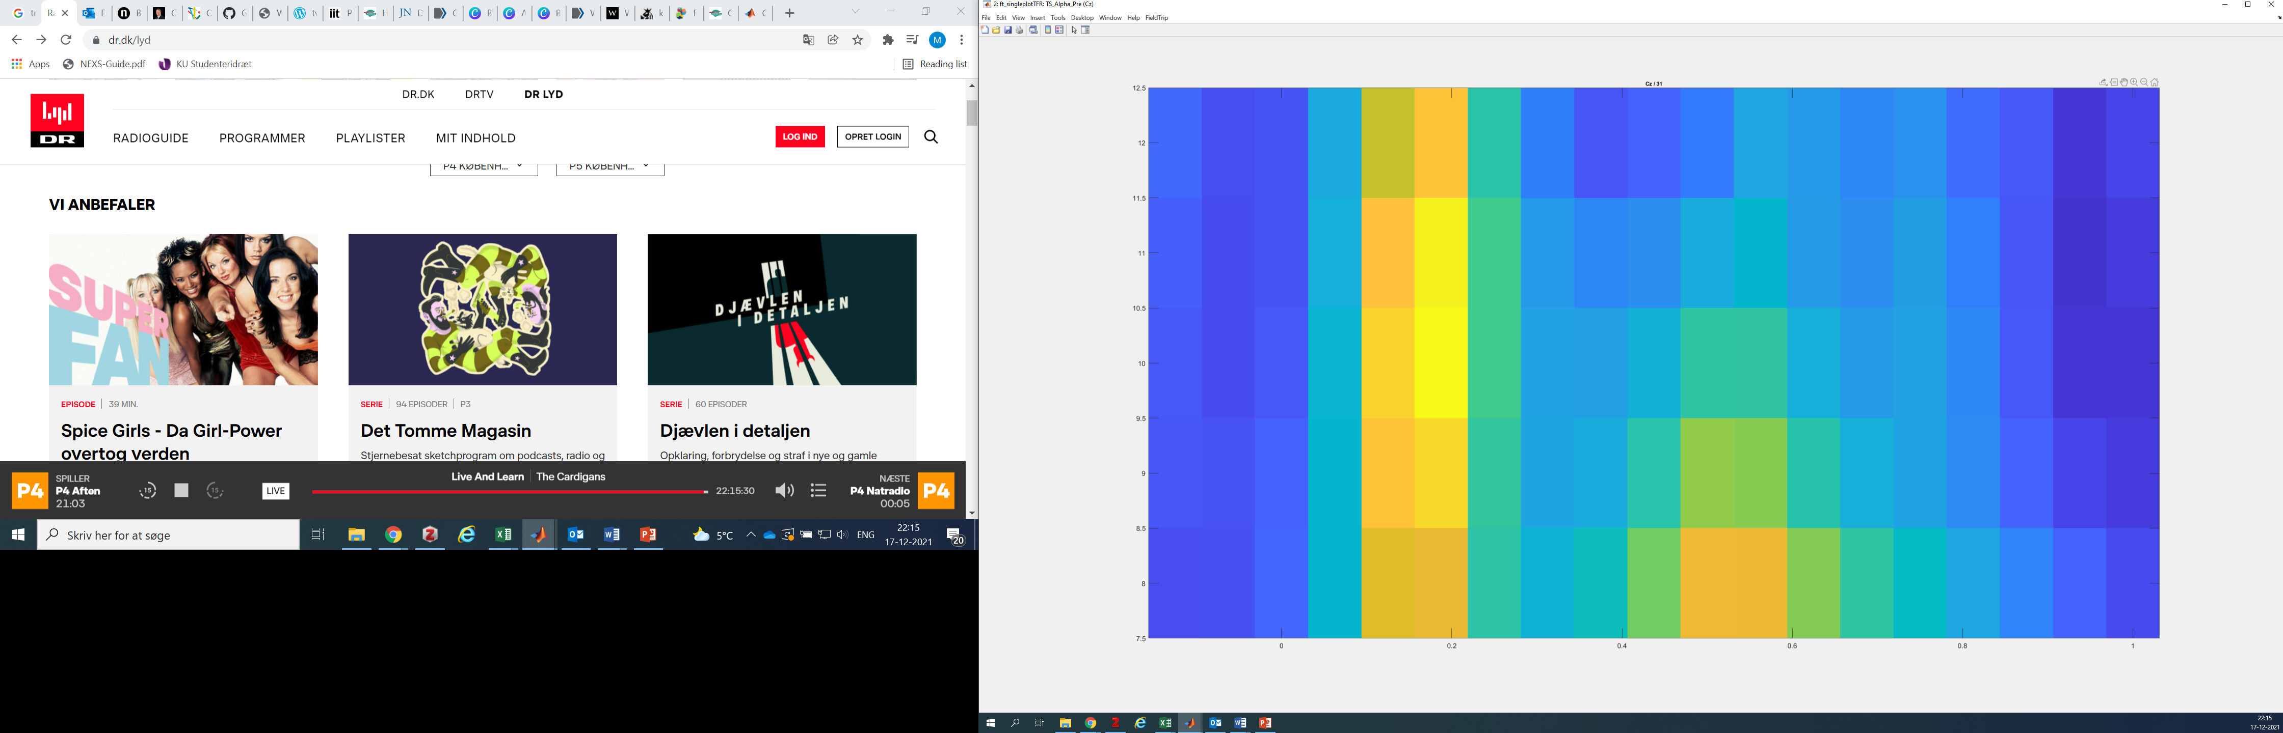
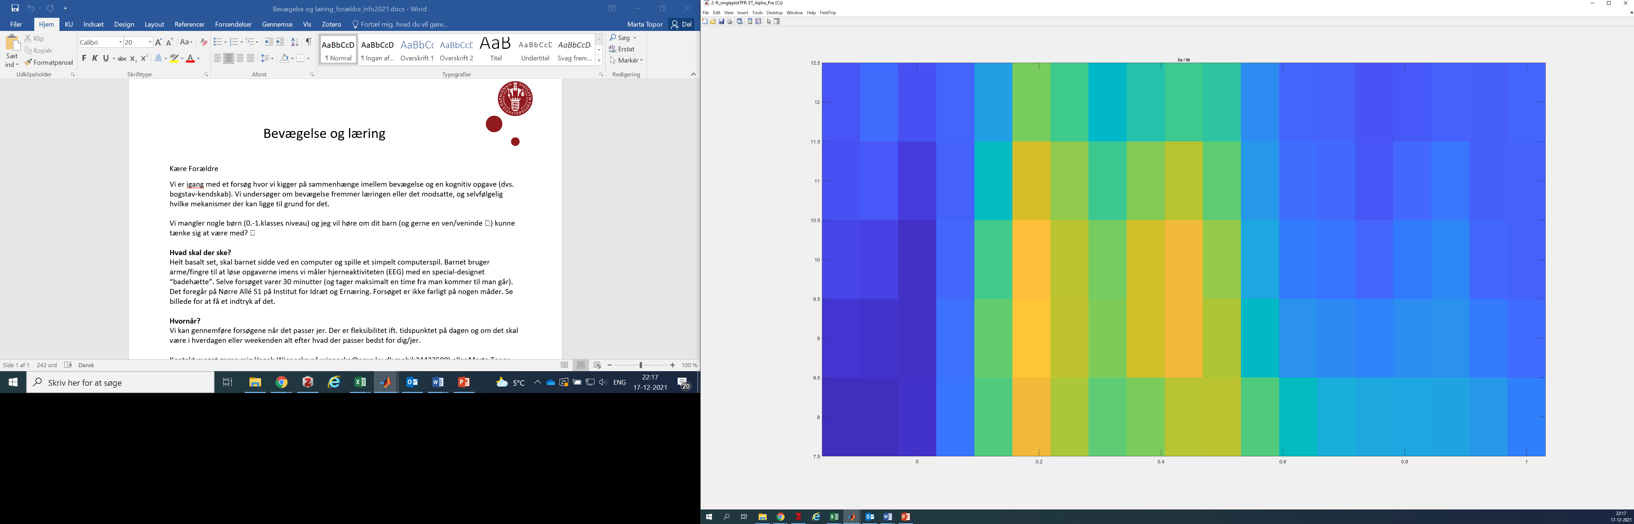
Alpha baseline by intervention
Cz Alpha at 0-600ms – no clusters so non-significant.
Cz Alpha at 0-600ms is non-significant at p=.140
Cz
Cz
Touch Screen
Eye Tracker
Touch Screen
Eye Tracker
20 Participants, Outliers removed, Divided by Intervention Group
18 Participants, Outliers removed, Divided by Intervention Group
Touch Screen
Eye Tracker
P300 during the intervention will be compared between the groups at Fz

Slide 8
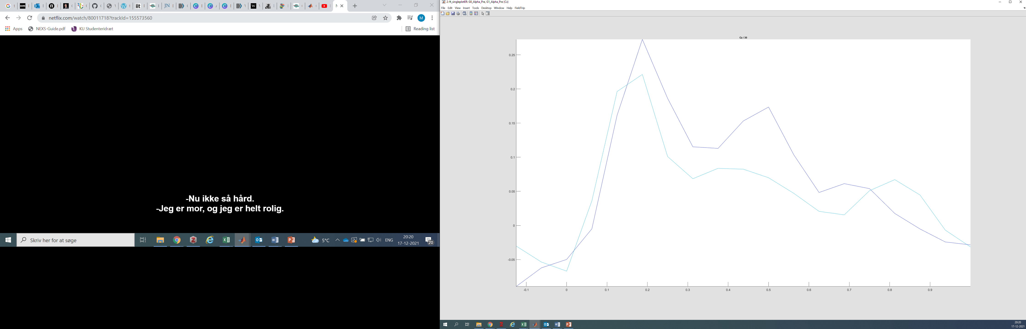
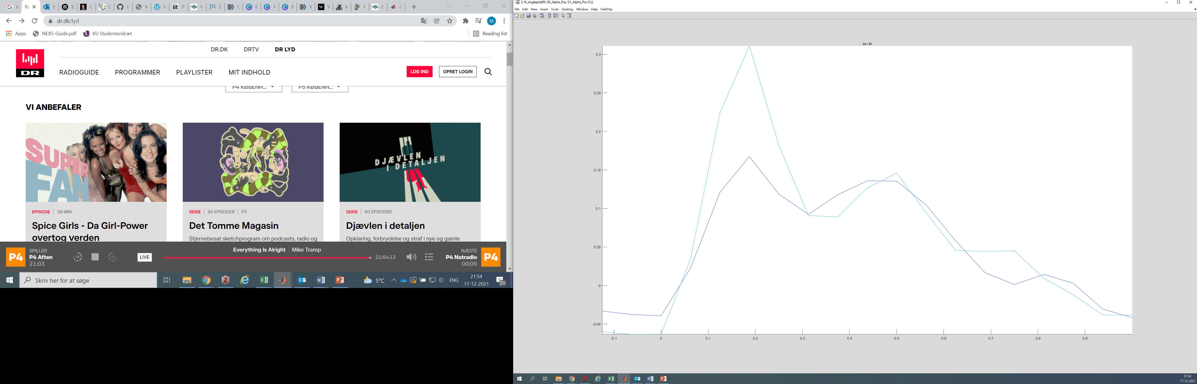
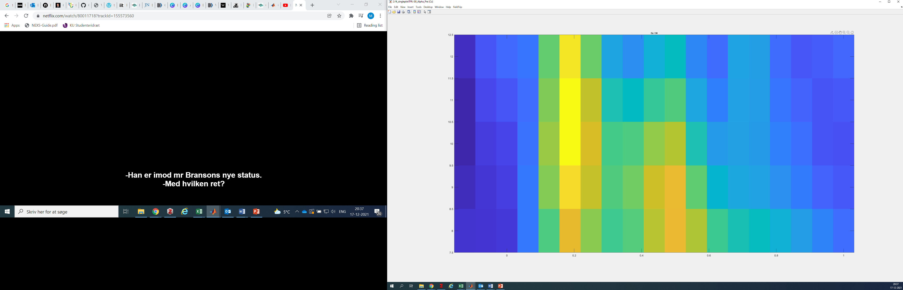
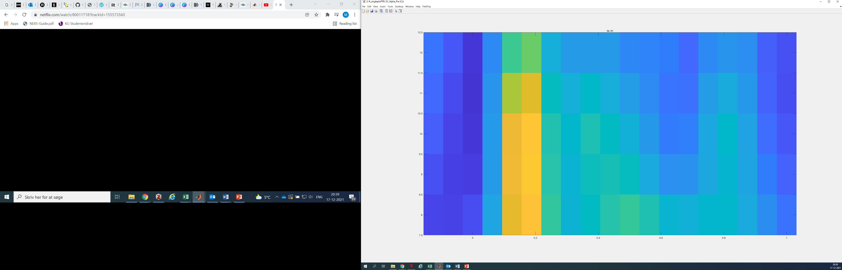
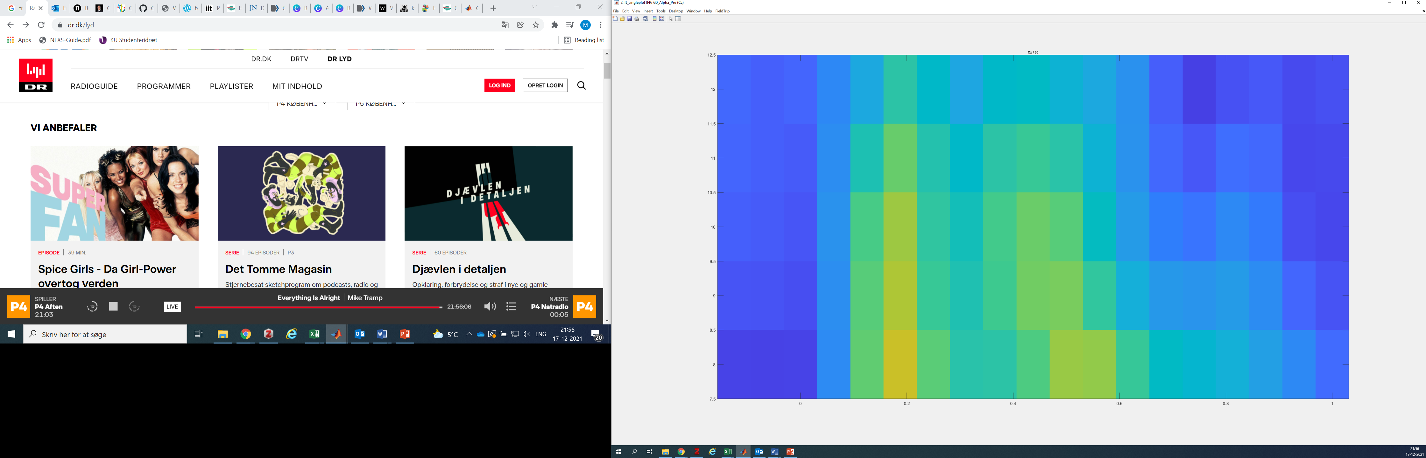
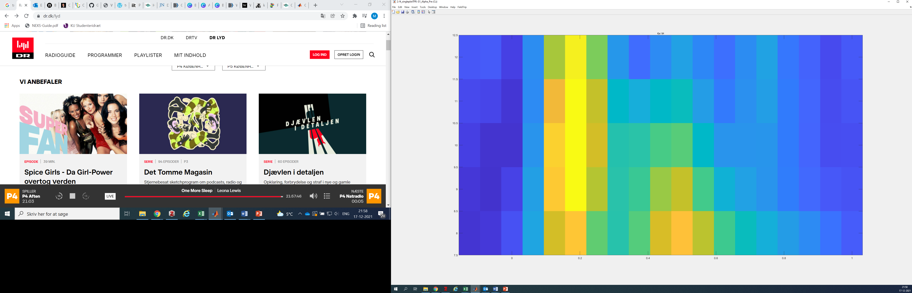
Alpha baseline by age
Cz Alpha at 0-600ms is non-significant at p=.257
Cz Alpha at 0-600ms is non-significant at p=.151
Cz
Cz
Grade 0
Grade 1
Grade 0
Grade 1
20 Participants, Divided by Age (10 in each group)
18 Participants, Outliers removed, Divided by Age (9 in each group)
Grade 1
Grade 0

Slide 9
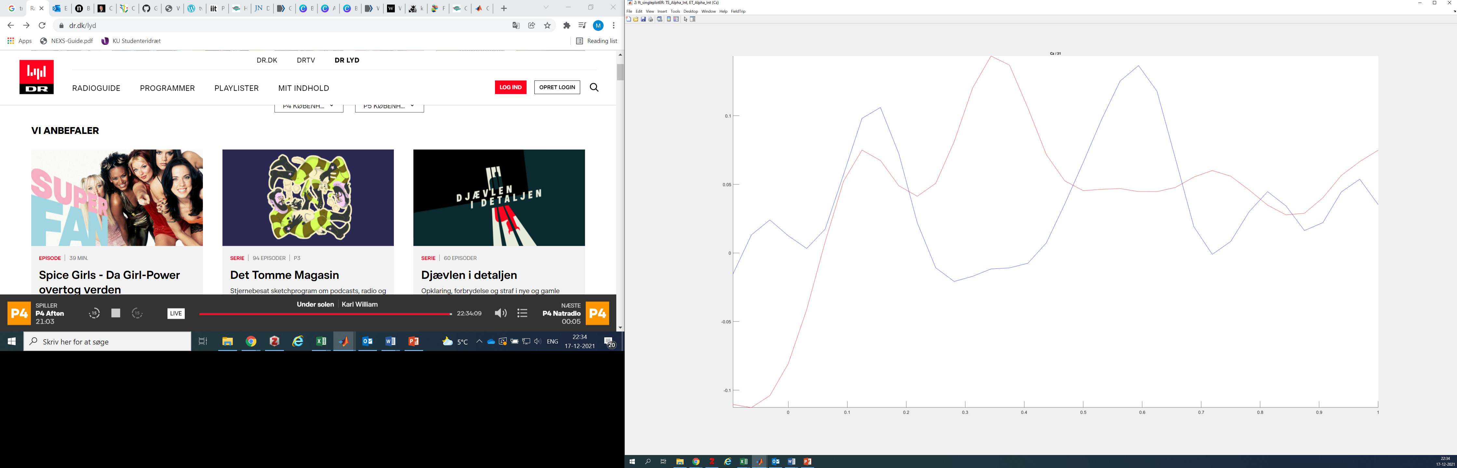

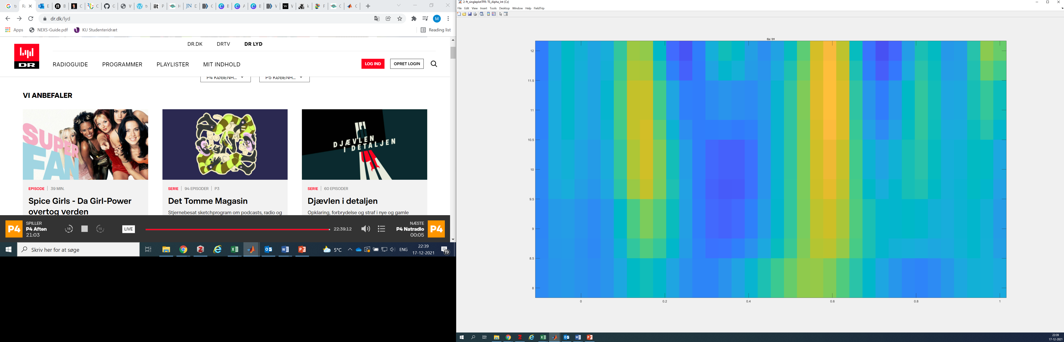
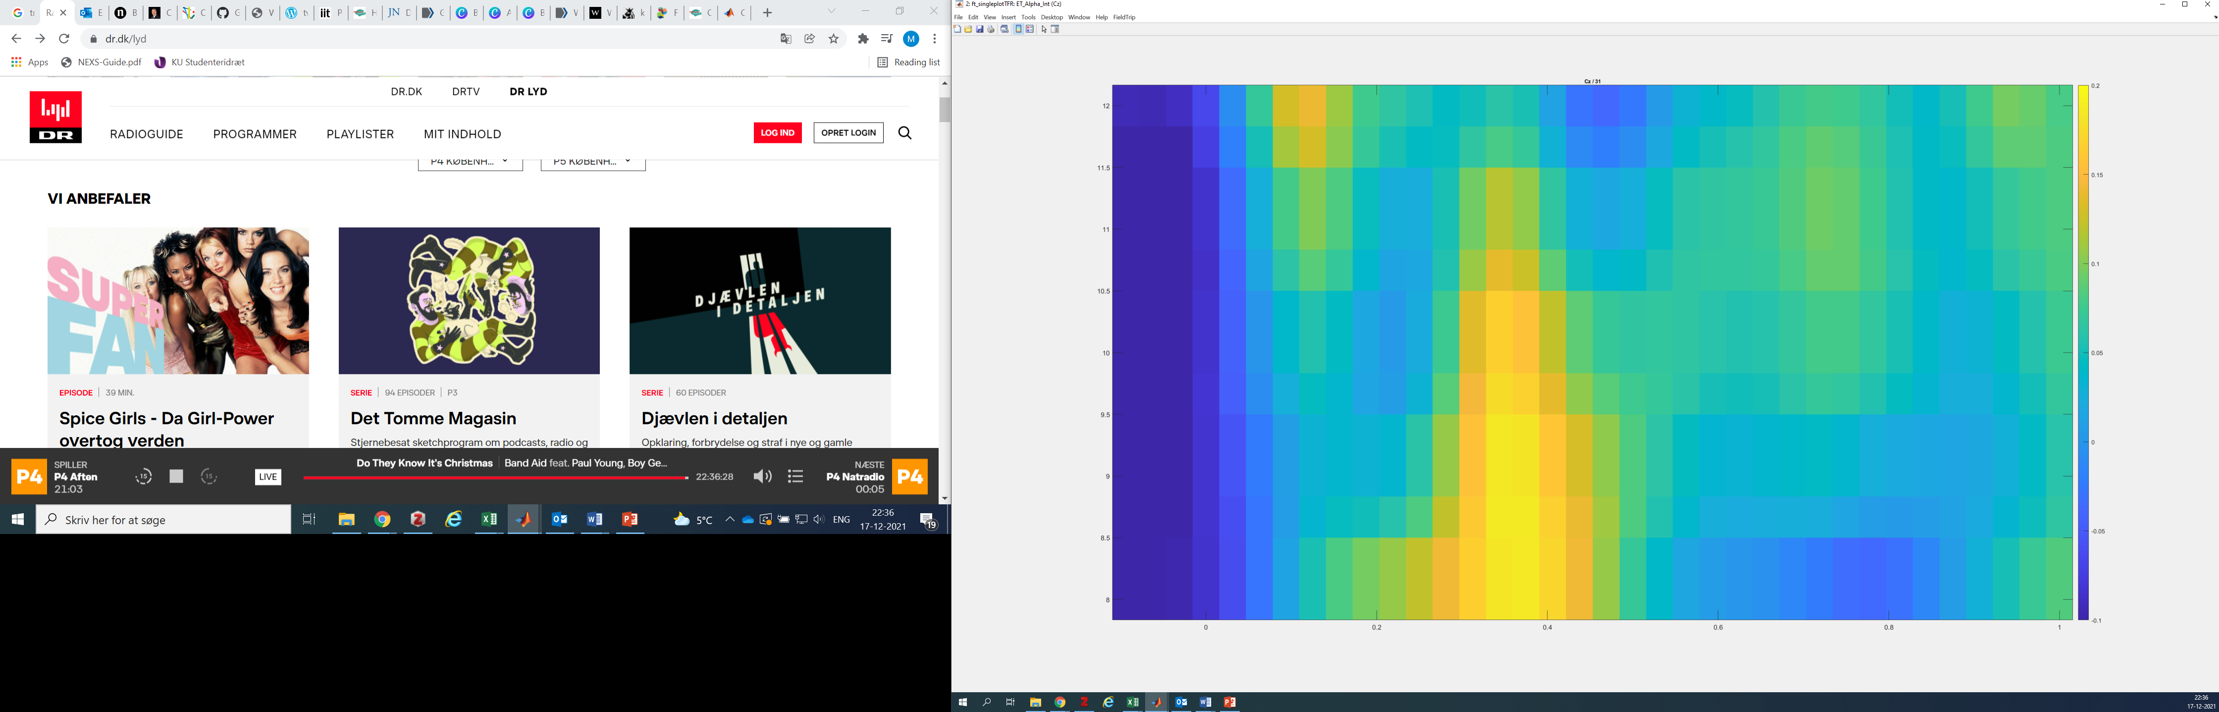
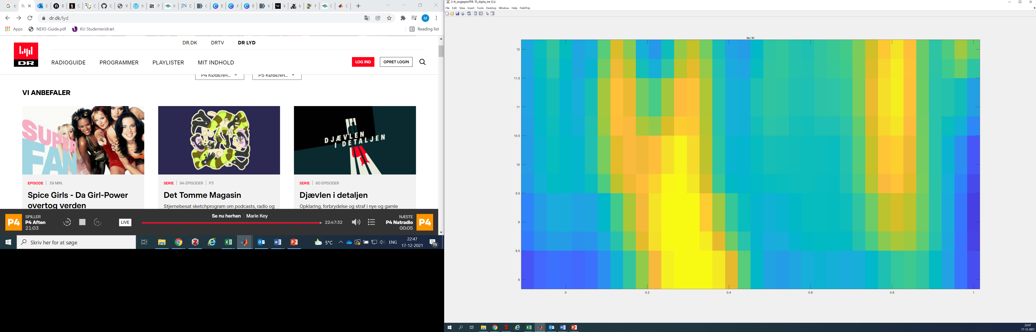
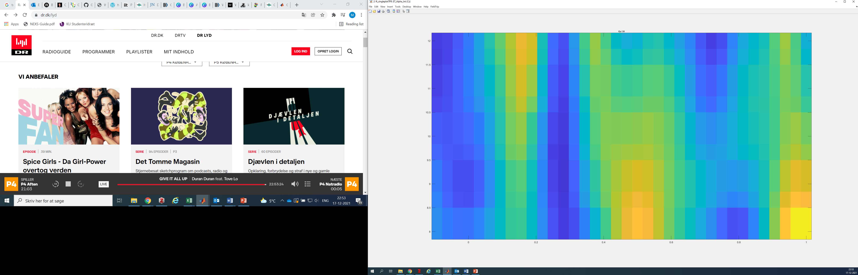
Alpha Intervention
Cz Alpha at 0ms-700ms during Intervention non-significant p=.143
Cz Alpha at 0ms-600ms during Intervention non-significant p=.172
Touch Screen
Eye Tracker
Touch Screen
Eye Tracker
20 Participants, Divided by Age (10 in each group)
18 Participants, Outliers removed, Divided by Age (9 in each group)
Touch Screen
Eye Tracker

